Slide 1
Deep learning introduction

Slide 2
ChatGPT
https://poe.com/

Slide 3
Rationale
Provide you with just enough intuition about deep neural networks to start implementing them.
Then learn by doing.

Slide 4
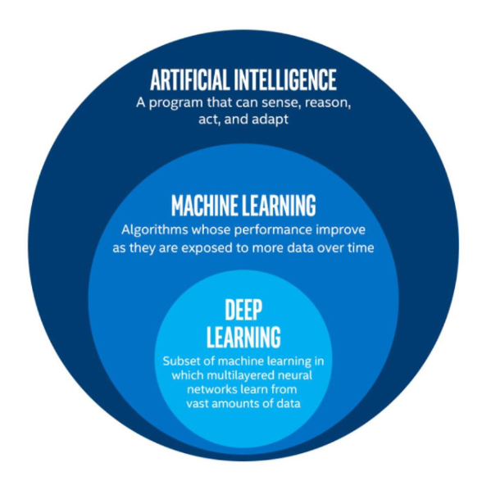
AI Landscape

Slide 5
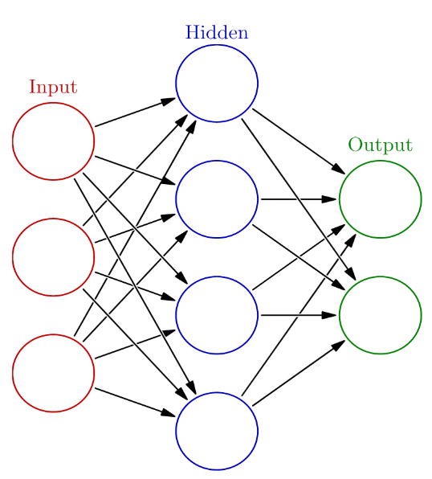
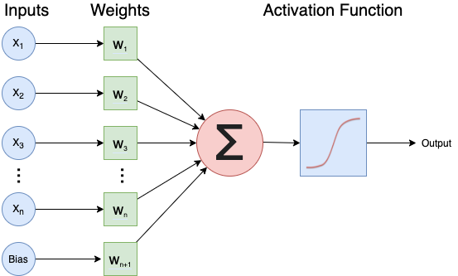
Neural network

Slide 6
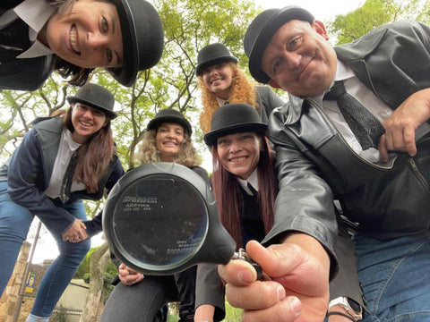
Networks as a team of detectives
Each neuron has a certain expertise, focusing on particilar patterns in the evidence (the input data)
Together they make a decision on who is guilty.

Slide 7
GPT-4 explaining what neurons do in GPT
Bills et al. (2023) trained GPT-4 to give explanations of what neurons in another GPT-4 network do:
https://openaipublic.blob.core.windows.net/neuron-explainer/paper/index.html#sec-intro

Slide 8
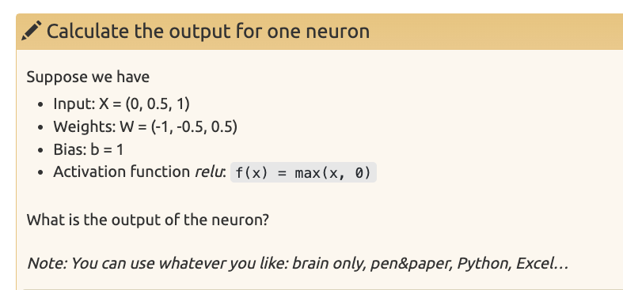

Slide 9
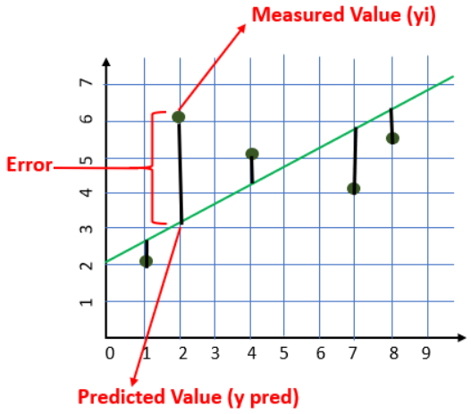

Slide 10
Why deep neural networks? Intuition.
No hidden layer, simple dataset
No hidden layer, complex dataset
Hidden layer, complex dataset

Slide 11
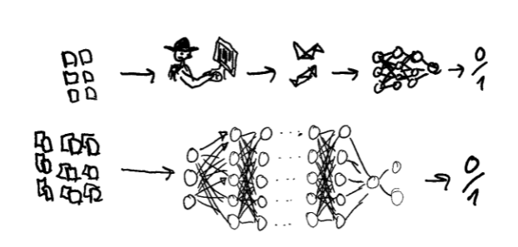
Deep vs shallow neural networks

Slide 12
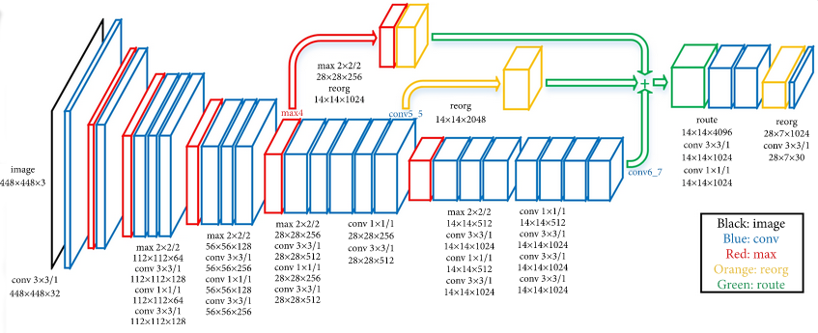
Example deep network
From https://www.kaggle.com/keras/resnet50

Slide 13
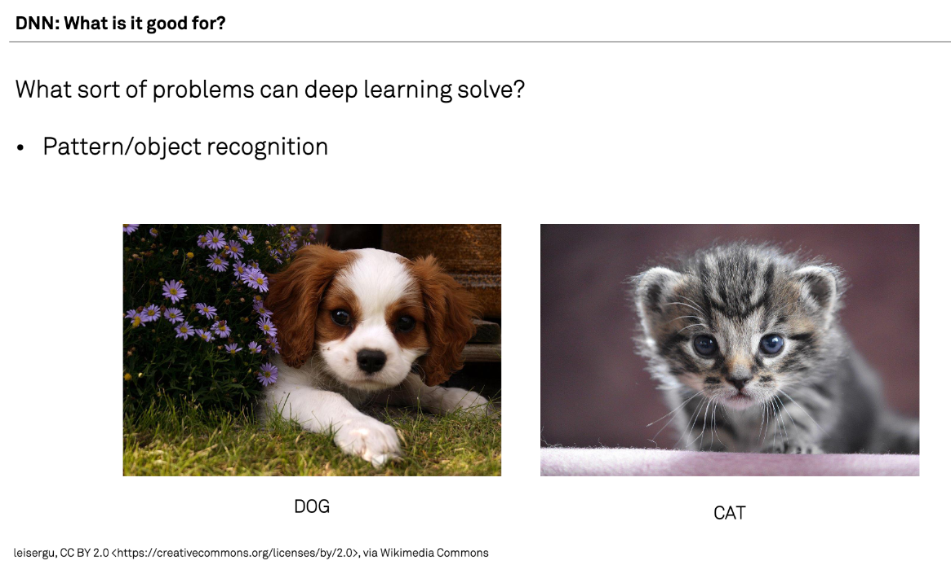

Slide 14
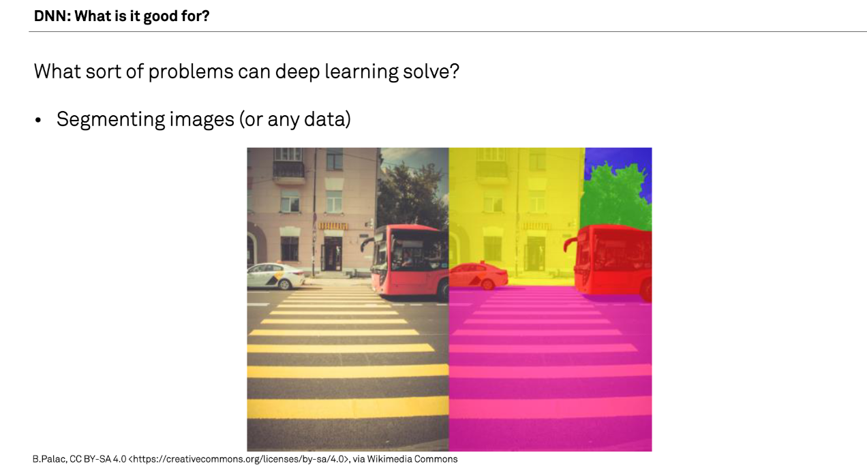

Slide 15
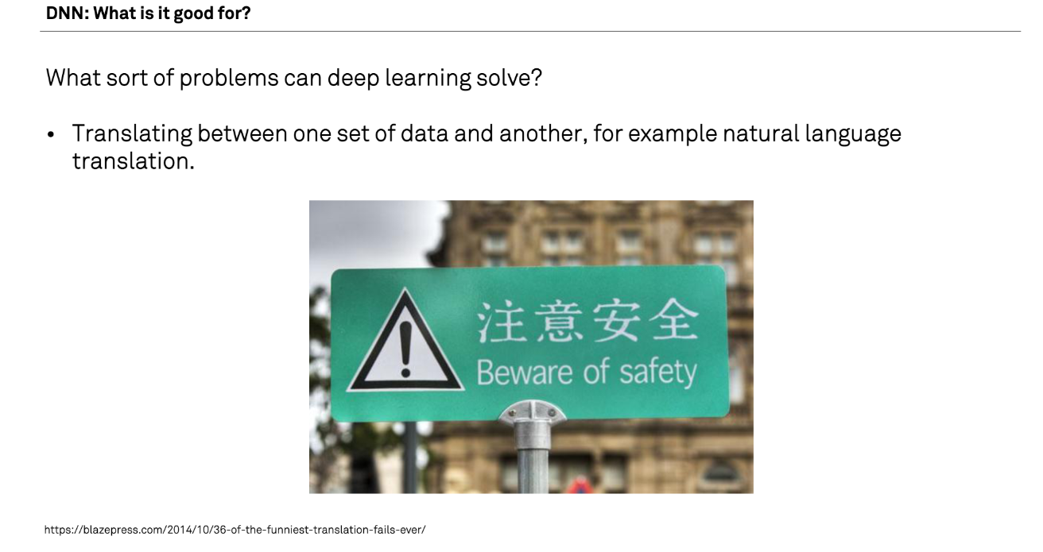

Slide 16
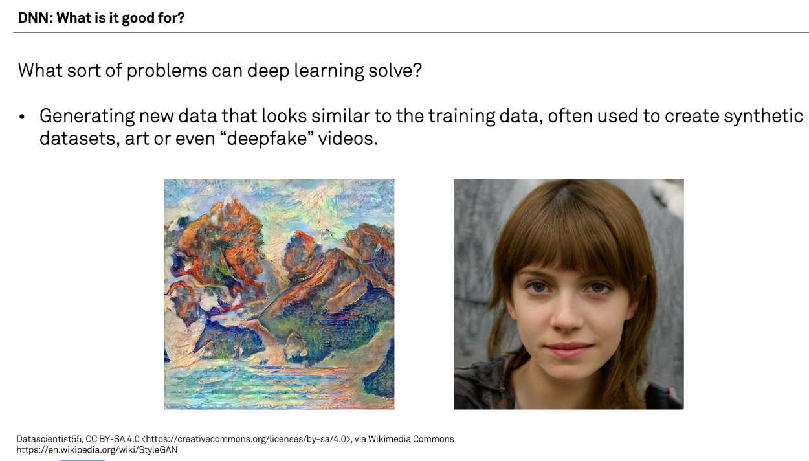
DNN: What is it good for?
What sort of problems can deep learning solve?
Generating new data that looks similar to the training data, often used to create synthetic datasets, art, or deepfake videos. A recent famous example: chatGP

Slide 17
What are examples that you have of deep learning applied to research?

Slide 18
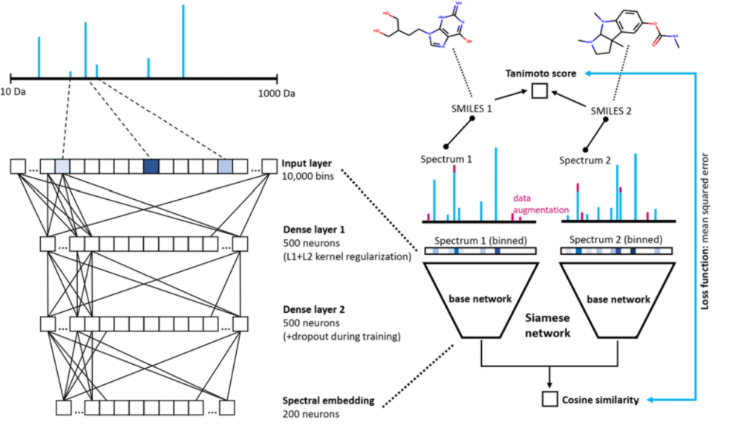
Example of Deep Learning applied to Research: MS2DeepScore: a novel deep learning similarity measure to compare tandem mass spectra

Slide 19
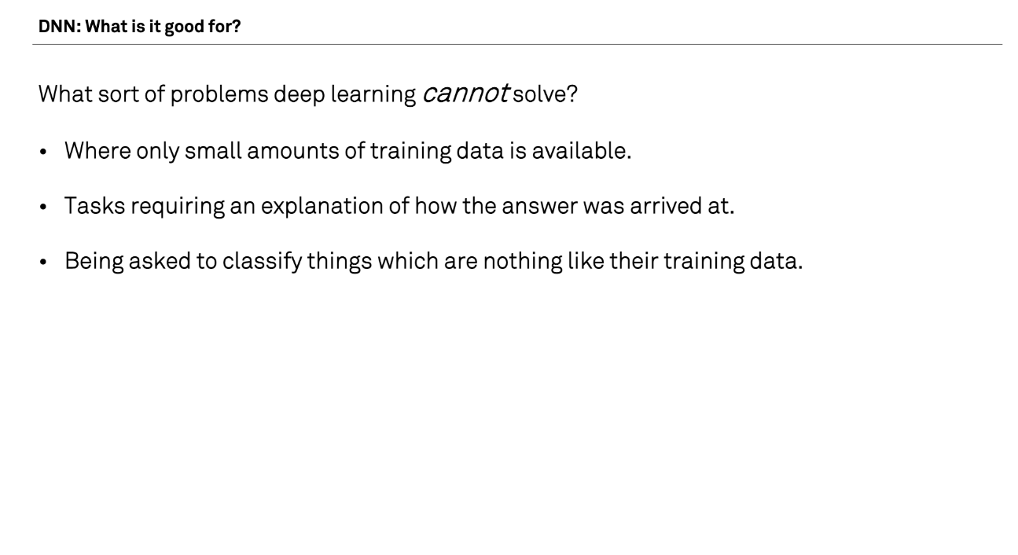

Slide 20
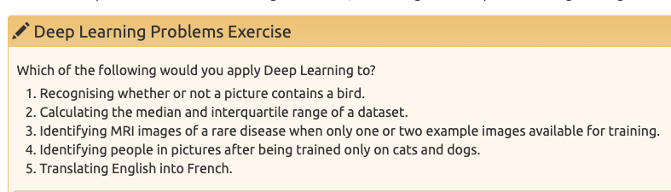

Slide 21
Deep learning workflow
Formulate/outline the problem
Identify inputs and outputs
Prepare data
Choose a pre-trained model or build a new architecture from scratch
Choose a loss function and optimizer
Train the model
Perform a Prediction
Measure Performance
Tune hyperparameters
Share model

Slide 22
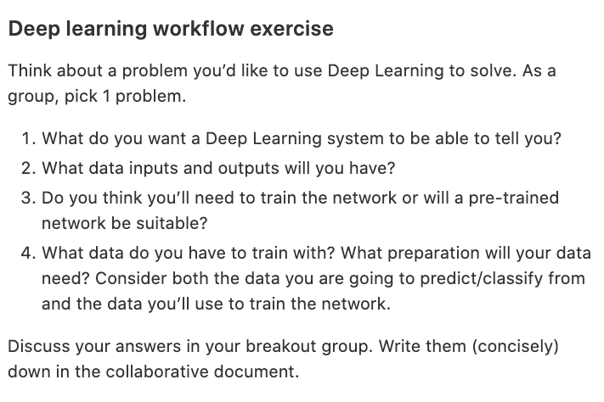

Slide 23
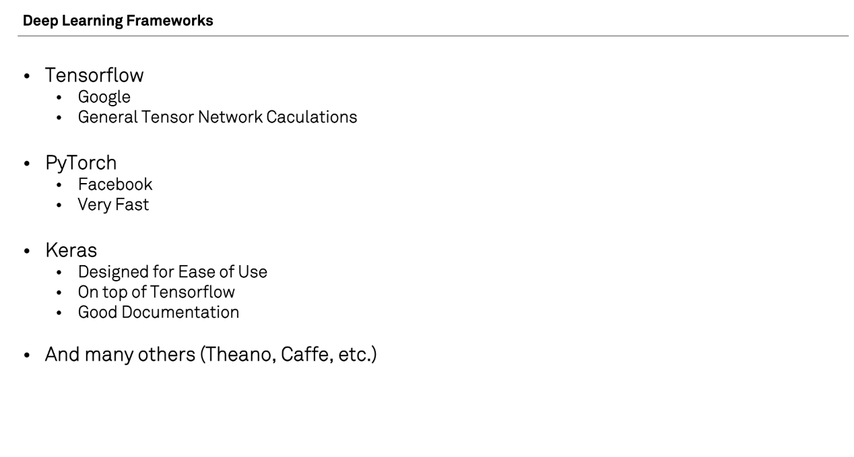

Slide 24
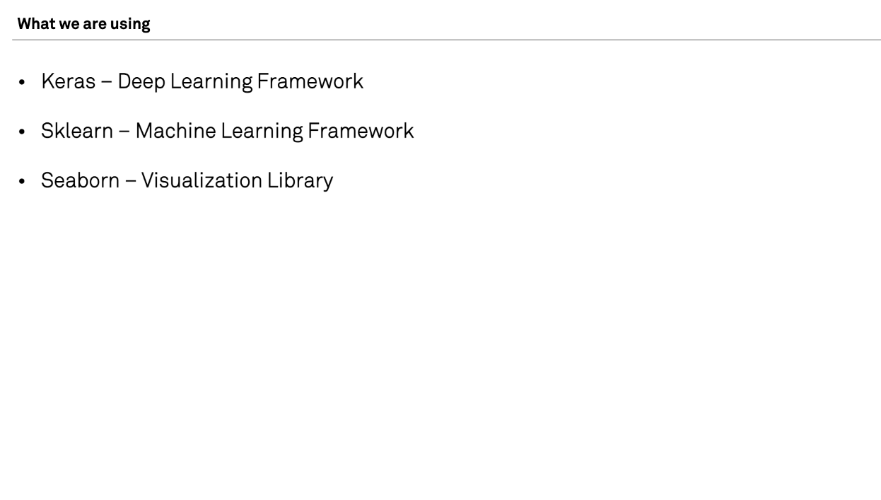

Slide 25
What have we learned?
What deep learning is
How neural networks work
When to apply deep learning
Applying deep learning with the ‘deep learning workflow’

Slide 26
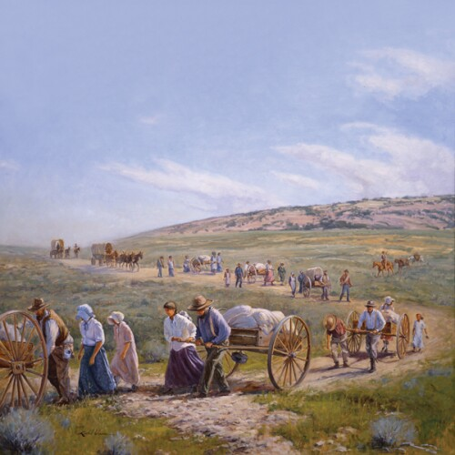
You are pioneers

Slide 27
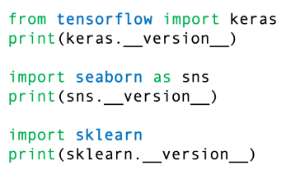
Check versions

Slide 28
Next steps
Practice!
For example try a Kaggle competition: https://www.kaggle.com/competitions
Read/watch blogs and videos
For example: 2-minute papers
Fast.ai course: making neural nets uncool again
https://course.fast.ai/
Try a quick and dirty approach first, then optimize
Get acces to a GPU
If experiments take seconds instead of 20 minutes, you can iterate over hypothesis -> experiment -> conclusion much much quicker

